Slide 1
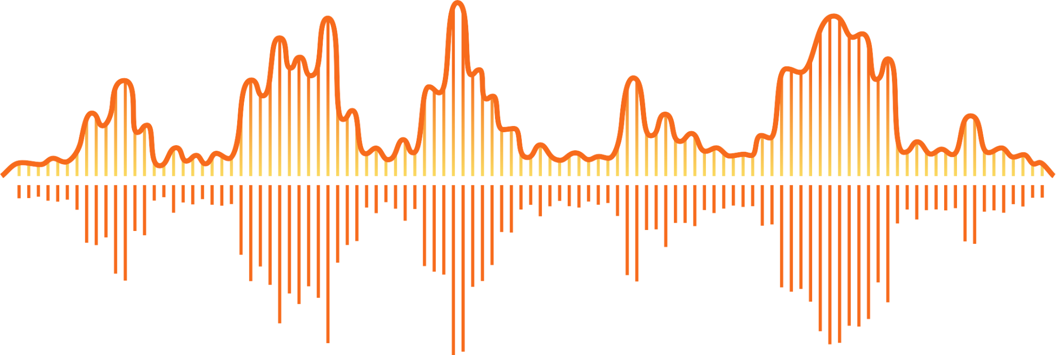
IOT BASED ACCELEROMETER
Presented by
Paras Sutar - 211060908
Ritik Mattami - 201060049
Yadnesh Dande - 211060903
Vishal Dhangar - 201060027

Slide 2
Table of content
1 | Problem statement
2 | Components
3 | Softwares
4 | Operation
5 | Actual Model
6 | Applications

Slide 3
Problem Statement

Slide 4
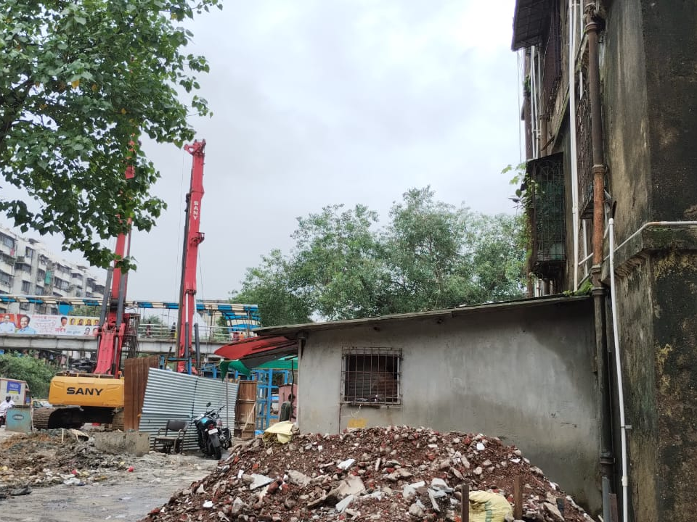

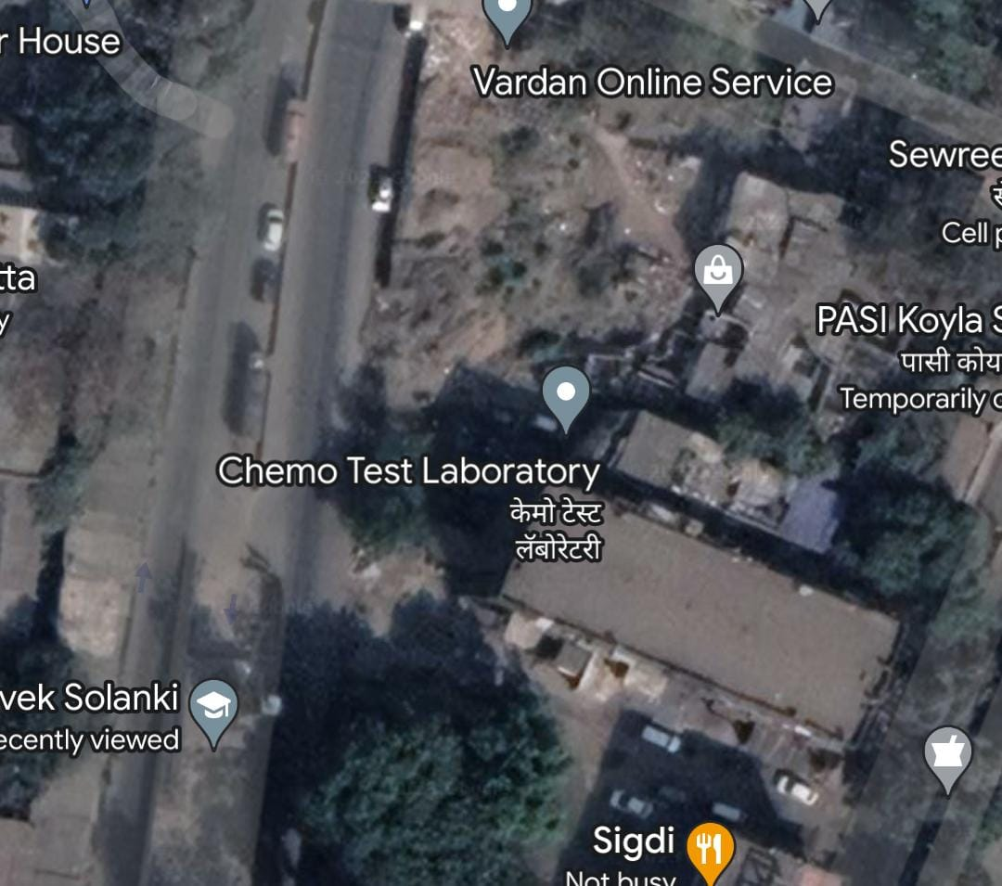


Slide 5
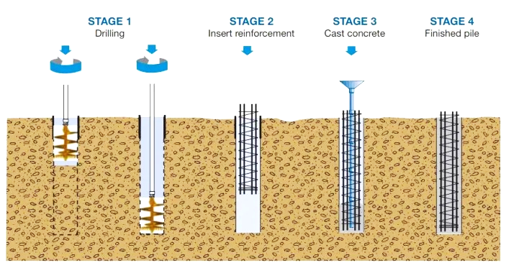
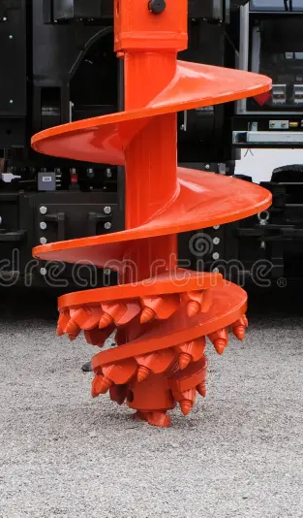

Slide 6
Components

Slide 7
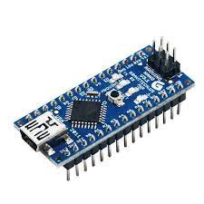
Arduino Nano
ATmega328P Microcontroller is from 8-bit AVR family
Operating voltage is 5V
Input voltage (Vin) is 7V to 12V
Input/Output Pins are 22
Analog i/p pins are 6 from A0 to A5
Digital pins are 14
Power consumption is 19 mA

Slide 8
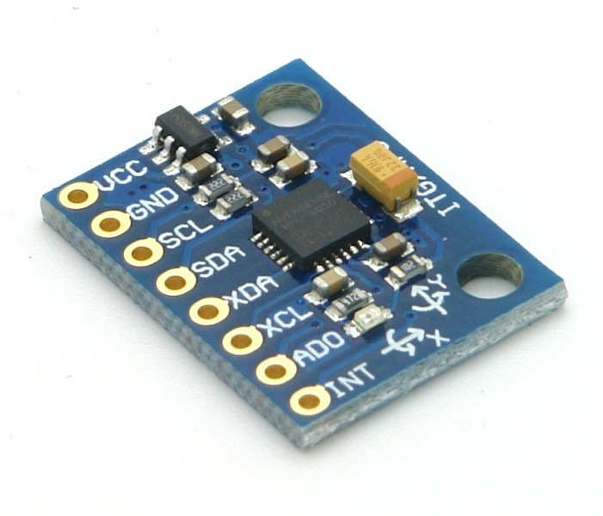
MPU6050 (vibration sensor)
3-axis sensing with a full-scale range of ±2g, ±4g, ±8g, or ±16g
Sensitivity of 16384, 8192, 4096, or 2048 LSBs per g
ODR range of 8 kHz to 1.25Hz
Temperature Sensor:
Operating range of -40°C to +85°C
Sensitivity of 340 LSBs per degree Celsius
Accuracy of ±3°C

Slide 9
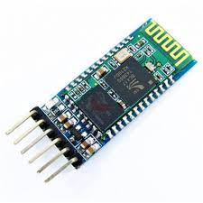
HC05 (Bluetooth Module)
Operating Voltage: 4V to 6V (Typically +5V)
Operating Current: 30mA.
Range: <100m.
Works with Serial communication (USART) and TTL compatible.
Follows IEEE 802.15.1 standardized protocol.

Slide 10


Softwares used
Arduino IDE
Vibrosense

Slide 11
Actual Model

Slide 12
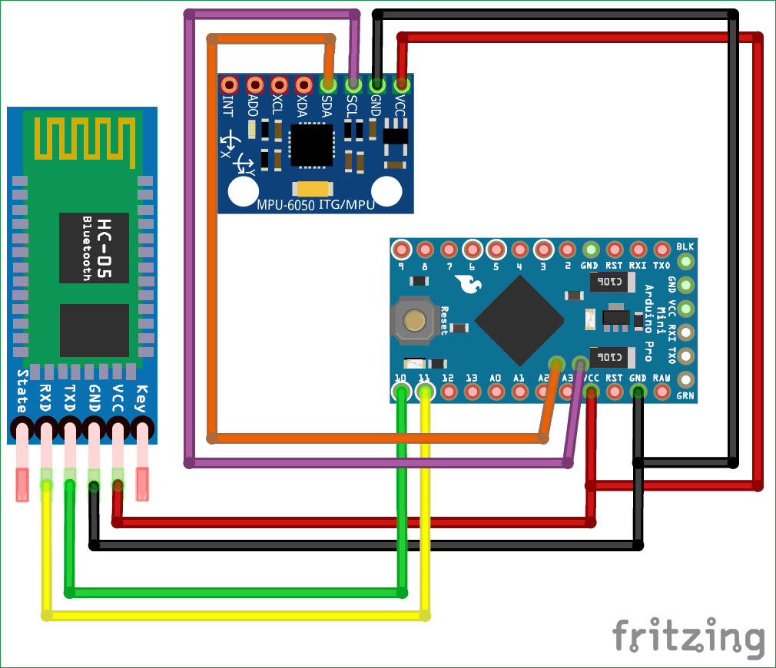
Circuit Diagram

Slide 13
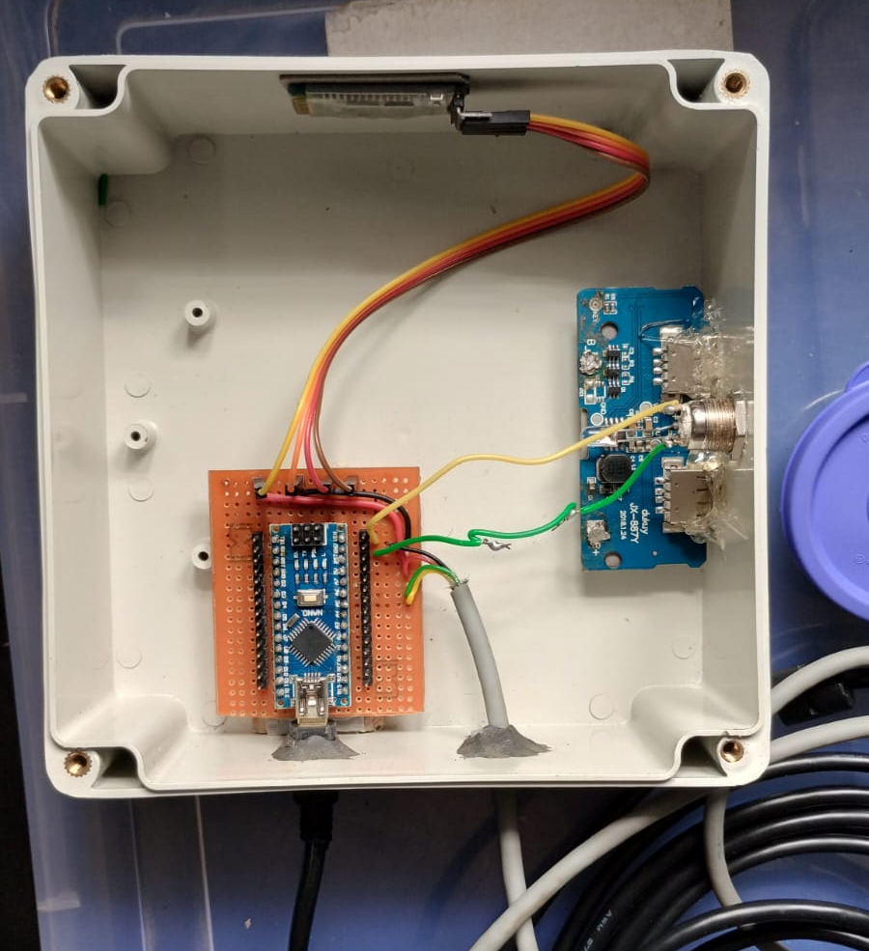
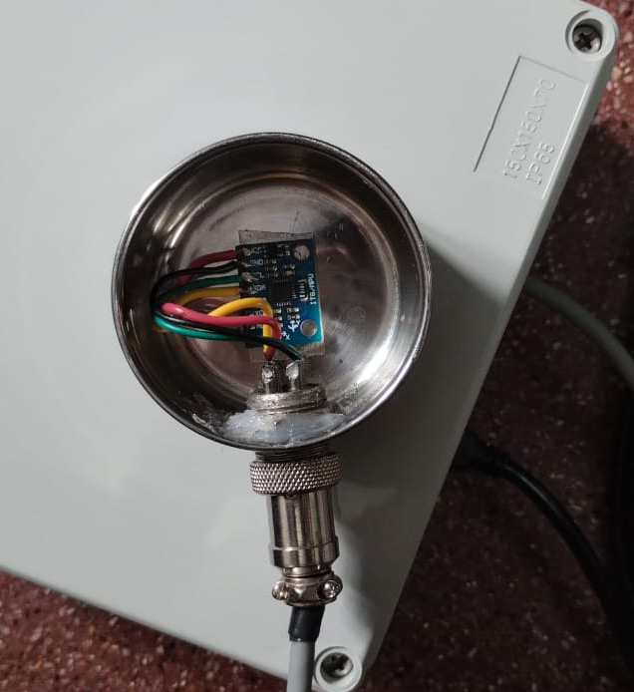
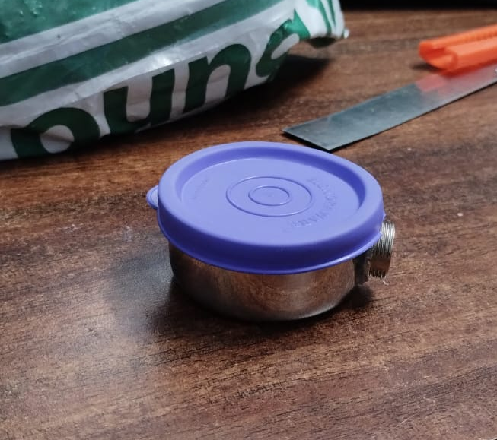
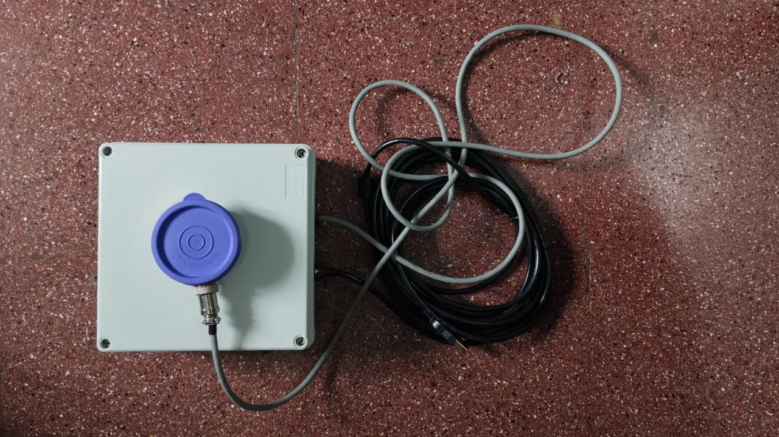
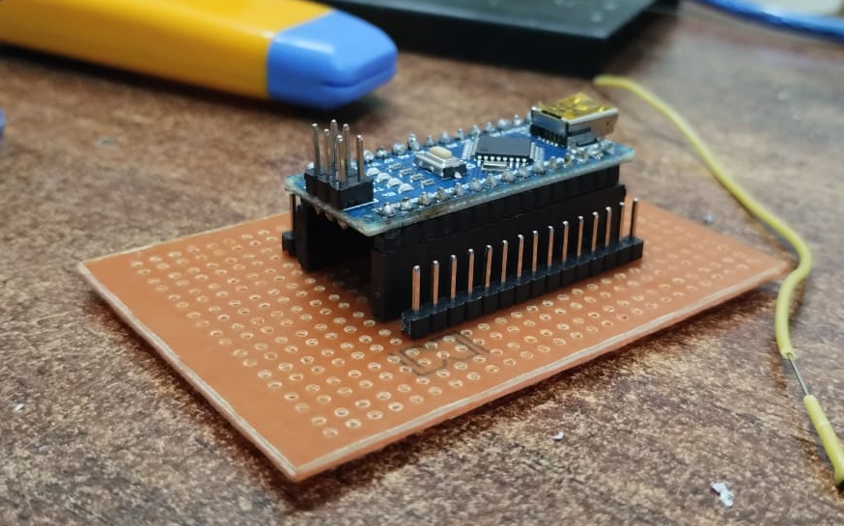
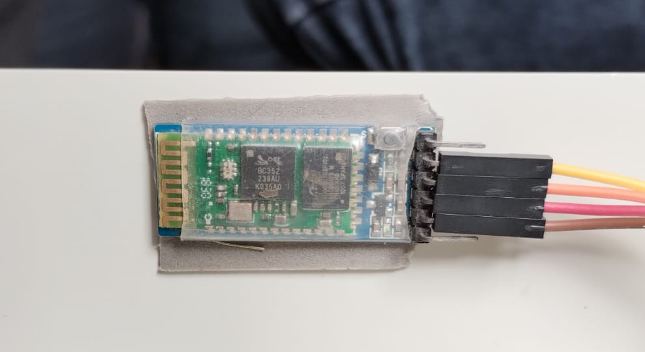

Slide 15
Operation

Slide 16
Sensor
DC O/P

Slide 17
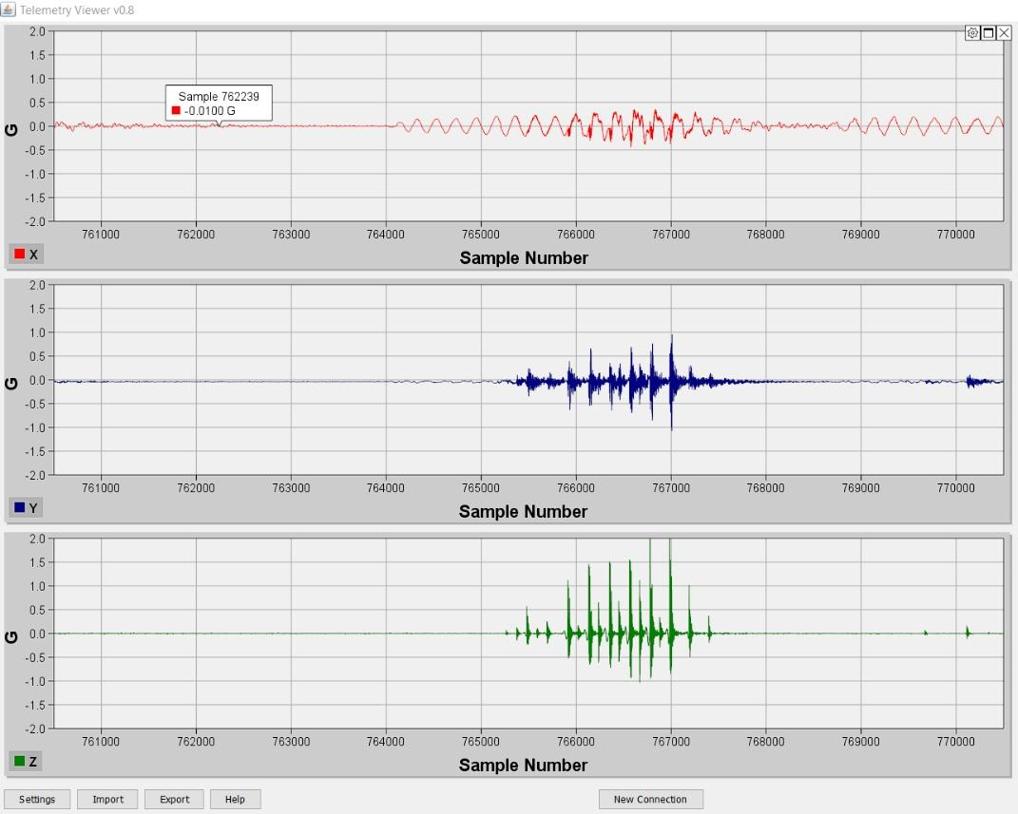
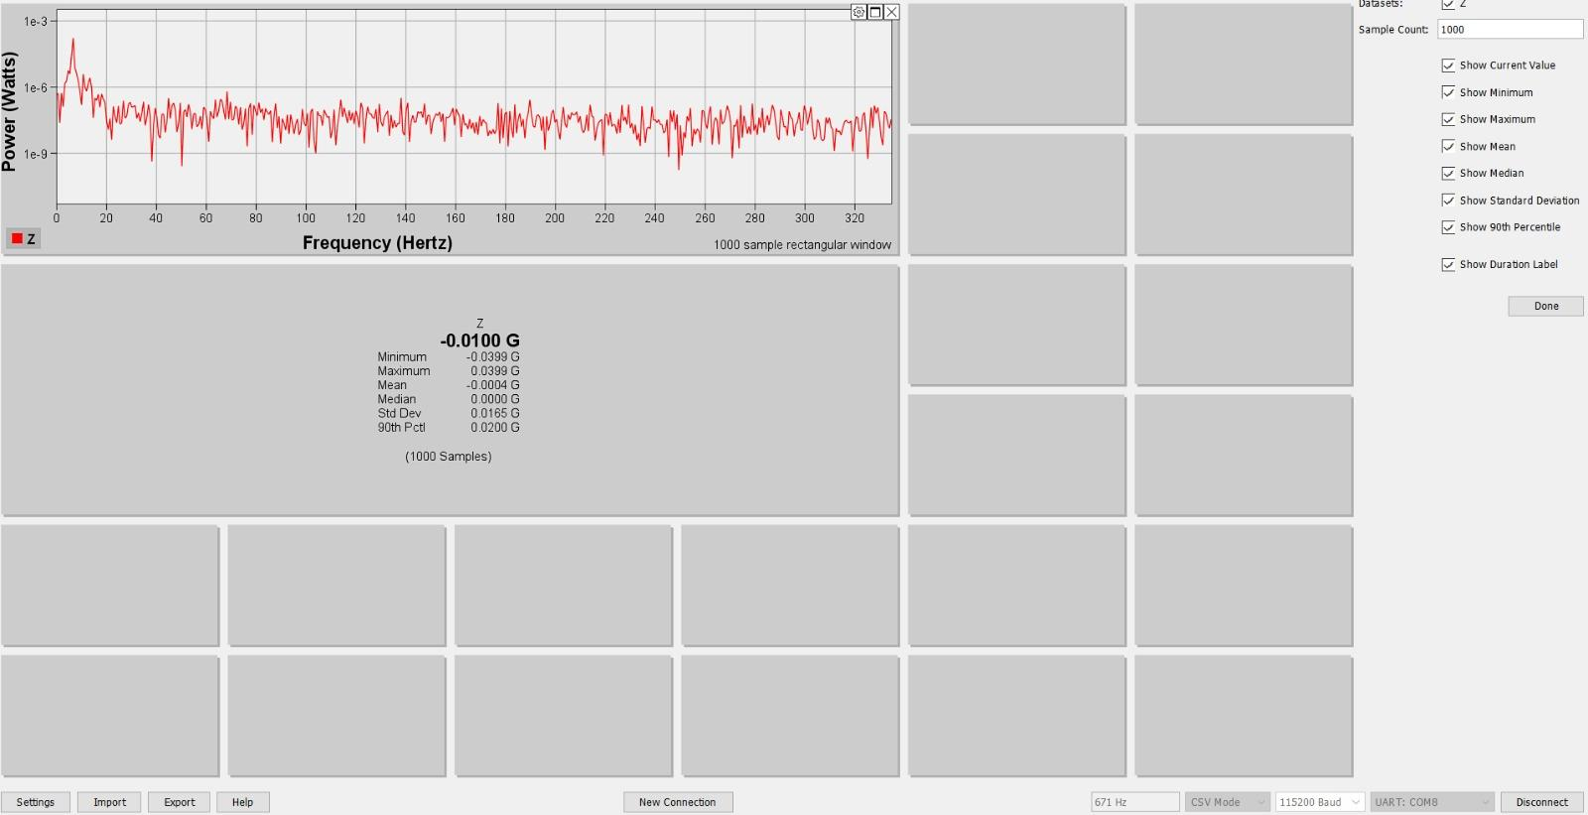

Slide 18
Features of our Model

Slide 19
Features of our Model
Compact Size
Easy portable
Tri-Axial
High data rate, so more accuracy
User friendly
Easy connections
Wireless transmission

Slide 20
Applications

Slide 21
Structural health monitoring
Environmental monitoring
Mining Areas
Engine Performance
Industrial machinery monitoring

Slide 22


